Slide 1
Digital Portfolio
STUDENT NAME: A Sangavi
REGISTER NO AND NMID: BA1040BB4EDBD388C58404AA14AFDD59
DEPARTMENT: BCA Computer application
COLLEGE: valliammai women’s College of Arts and science/annamalai university

Slide 2
PROJECT TITLE
Creating a student portfolio using FWD

Slide 3


AGENDA
Problem Statement
Project Overview
End Users
Tools and Technologies
Portfolio design and Layout
Features and Functionality
Results and Screenshots
Conclusion
Github Link
3/21/2024 Annual Review

Slide 4

PROBLEM STATEMENT
Title: "Creating a Creative Student Portfolio"
- Problem Statement: "As a student, I want to
showcase my projects and skills in a visually
appealing and easy-to-navigate portfolio, so that I
can demonstrate my capabilities to potential
employers and peers."

Slide 5

PROJECT OVERVIEW
Title: “FWD Creative Student Portfolio”
- Project Description: “A web-based portfolio
showcasing my projects, skills, and experience in
front-end development, web design, and other
creative pursuits.”
Goals:
- Showcase projects and skills
- Demonstrate creativity and technical abilities
- Easy to navigate and visually appealing

Slide 6

WHO ARE THE END USERS?
Title: “Target Audience”
- Description: “Potential employers, peers, and
mentors who want to view my projects and skills.”
- User Personas:
- Employers looking for skilled
developers/designers
- Peers seeking inspiration or collaboration
opportunities
- Mentors providing guidance and feedback

Slide 7

TOOLS AND TECHNIQUES
Title: “Technologies Used”
- List:
- HTML/CSS/JavaScript
- Front-end framework (e.g., React)
- Design tools (e.g., Figma, Adobe XD)
- Version control (e.g., GitHub)

Slide 8
POTFOLIO DESIGN AND LAYOUT
Title: “Design Concept”
- Description: “A clean, modern design with a focus on
showcasing projects and skills.”
- Layout:
- Hero section with introduction and call-to-action
- Project showcase with images, descriptions, and
links
- Skills and experience section
8

Slide 9
FEATURES AND FUNCTIONALITY
Title: “Key Features”
- List:
- Responsive design for mobile and desktop
- Project filtering and sorting
- Interactive elements (e.g., animations, hover
effects)
- Contact form or email link

Slide 10

RESULTS AND SCREENSHOTS
Title: “Portfolio Showcase”
- Screenshots:
- Description: “A visually appealing and functional portfolio
that showcases my skills and experience.”
3/21/2024 Annual Review
10

Slide 11
CONCLUSION
Title: "Conclusion"
- Summary: "My FWD creative student portfolio
showcases my skills and experience in front-end
development, web design, and other creative
pursuits."
- Call-to-Action: "View my portfolio and let's
connect!"
11

Slide 12
GitHub
Title: "GitHub Repository“
- Link: https://github.com/Asangavi2007
- Description: "View the code for my portfolio on GitHub."

Slide 13
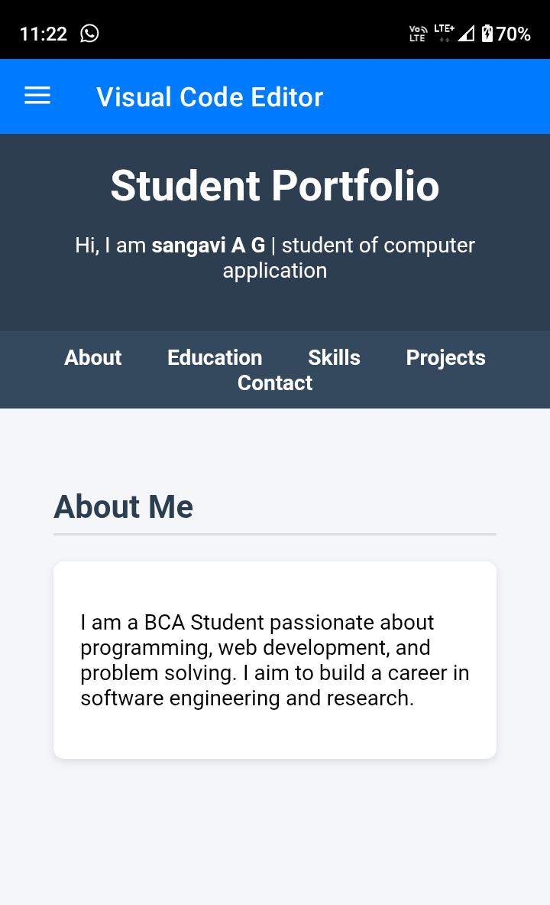
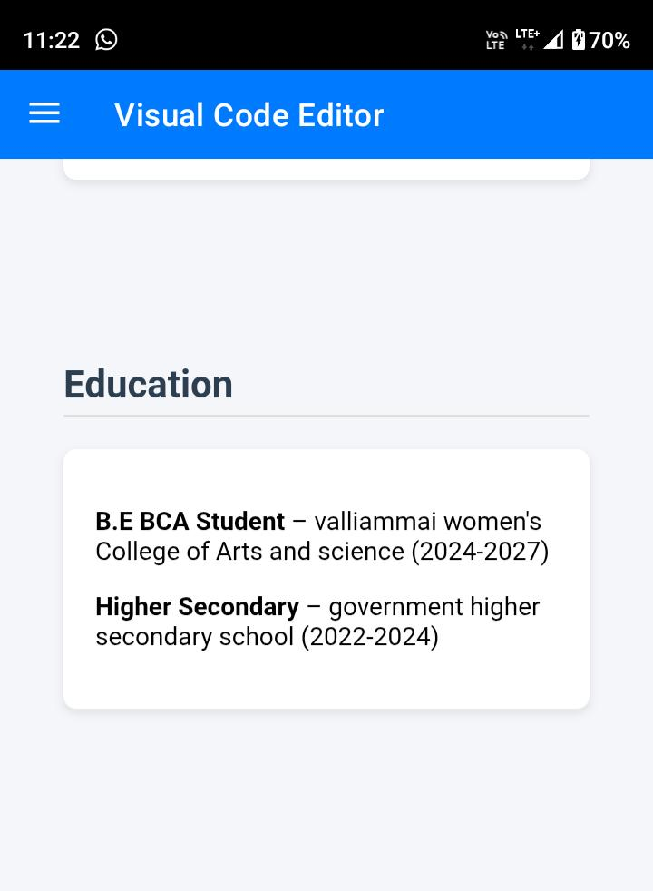
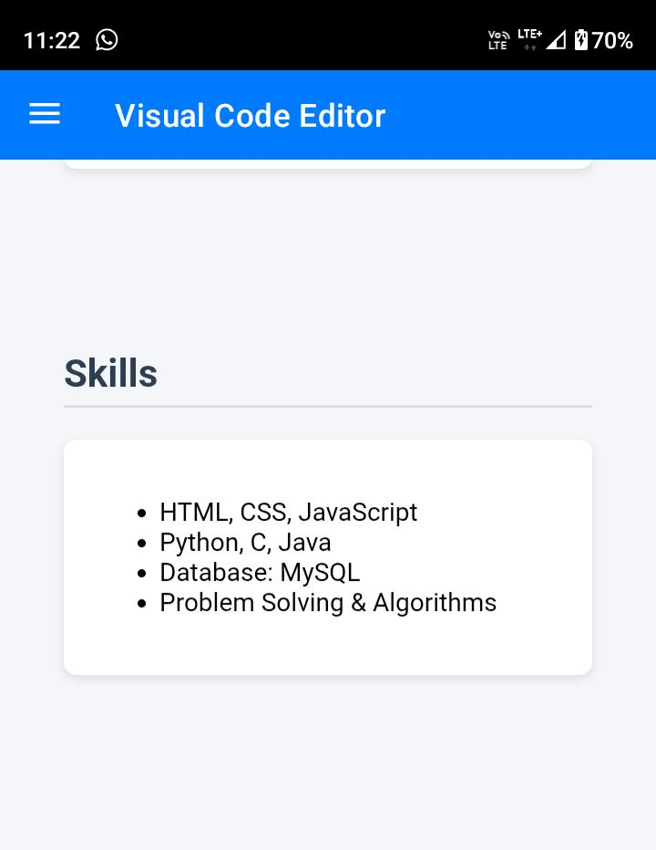

Slide 14
